Slide 1
ARTs lab meeting
Puja Chowdhury
Date: 15/2/22

Slide 2
FPGA LabVIEW tutorial
https://www.youtube.com/watch?v=4MYrtynlWxg
https://www.youtube.com/watch?v=uRWhGq7UN74
https://www.youtube.com/watch?v=soE_9478BbY
https://www.youtube.com/watch?v=-XoPES2D4z0
https://learn.ni.com/learn/article/getting-started-with-fpga
https://www.ni.com/documentation/en/labview-comms/1.0/design/fpga-design-flow/

Slide 3
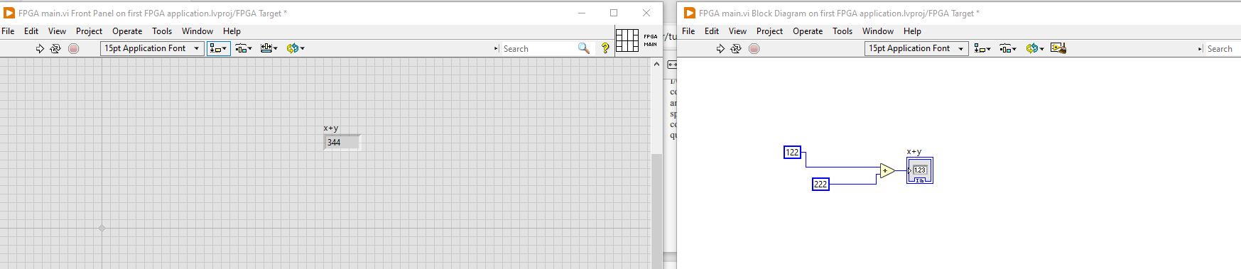
Start from beginning
Build in FPGA (like target)
Simple addition
Compile

Slide 4
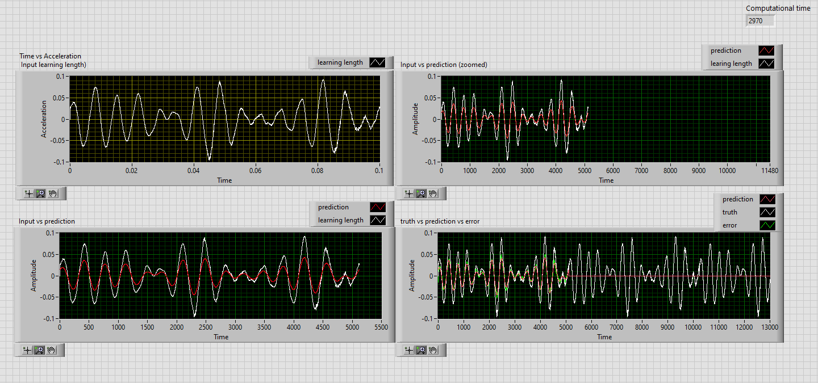
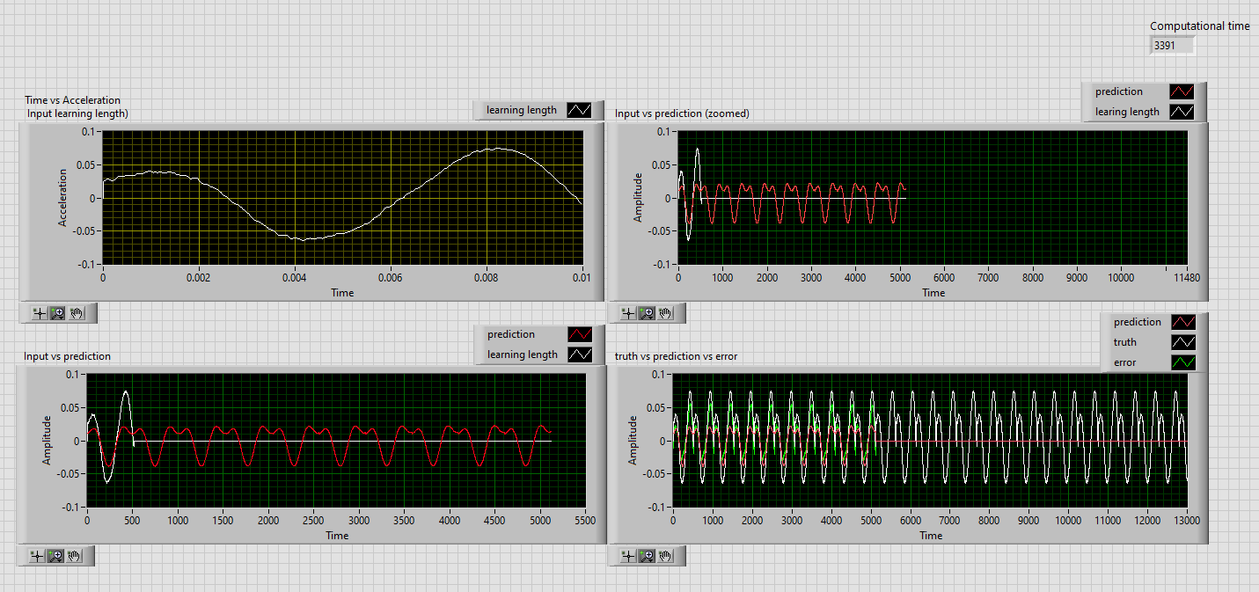
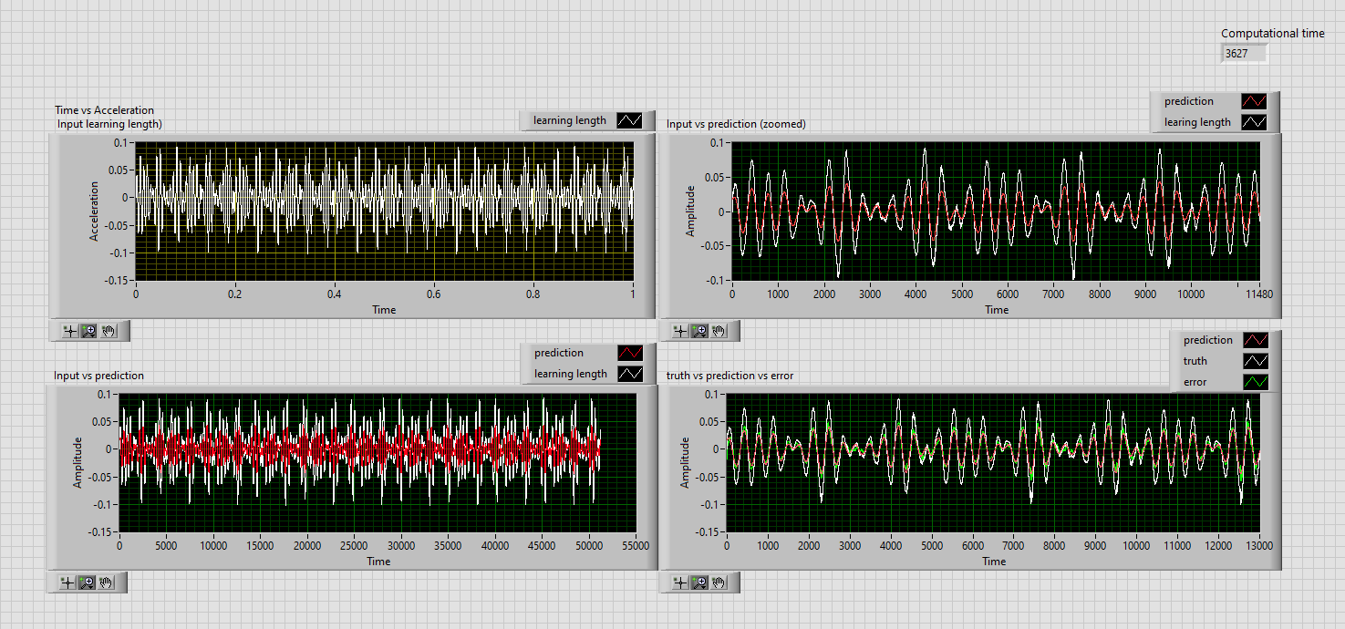
Labview implimentation

Slide 5
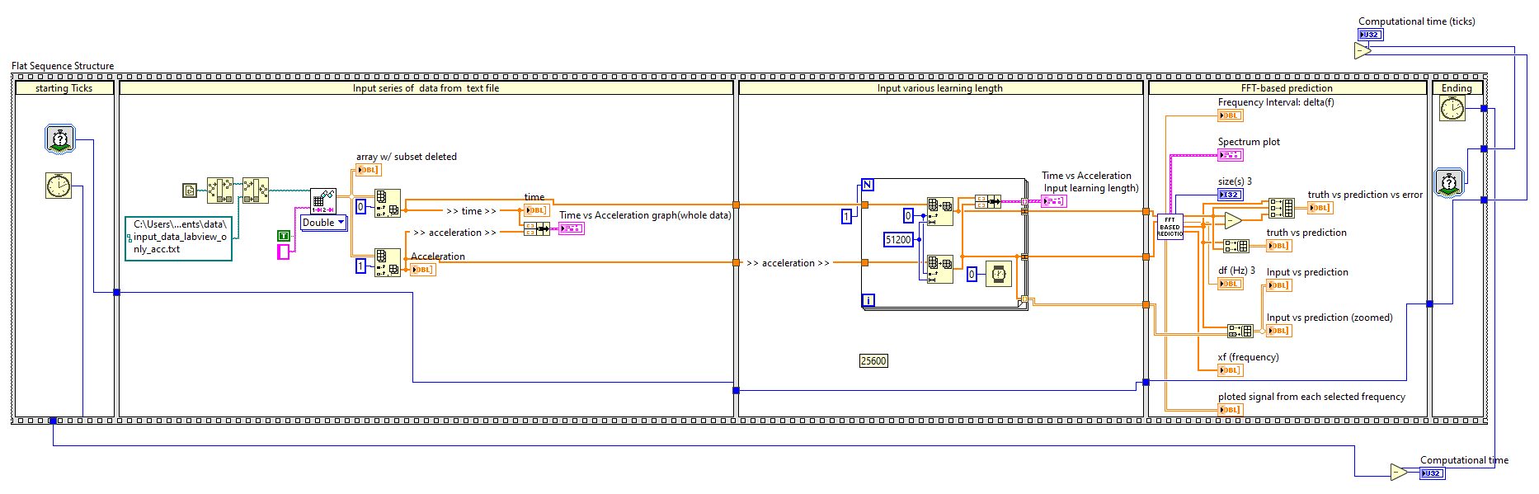
Labview code

Slide 6
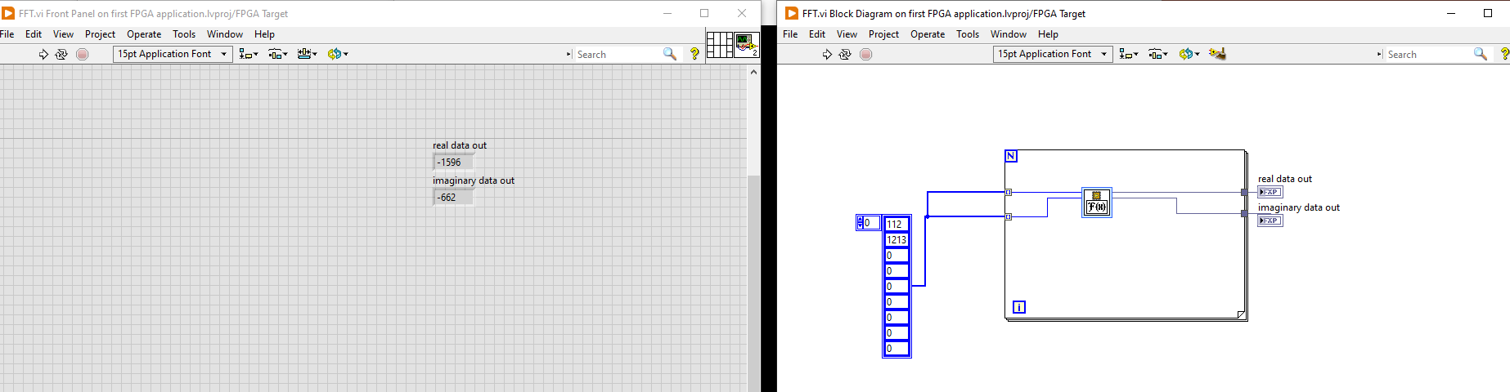
Start from beginning
Build in FPGA (like target)
Array constant (p-69)
Compile

Slide 7
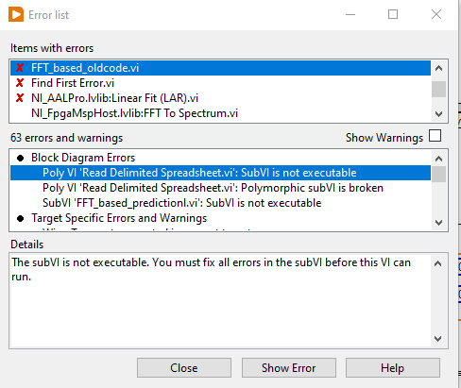
Labview code transfer to FPGA labVIEW

Slide 8
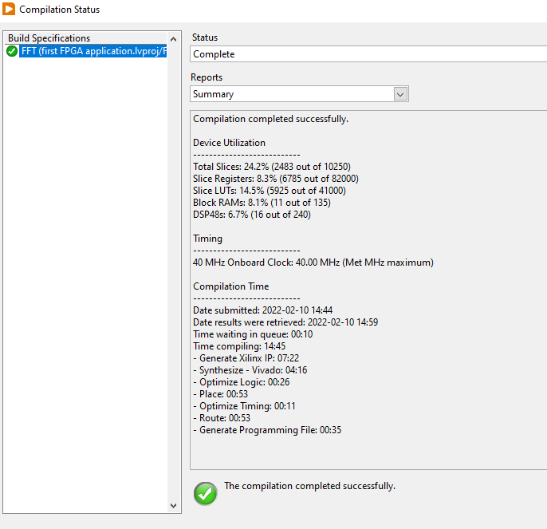
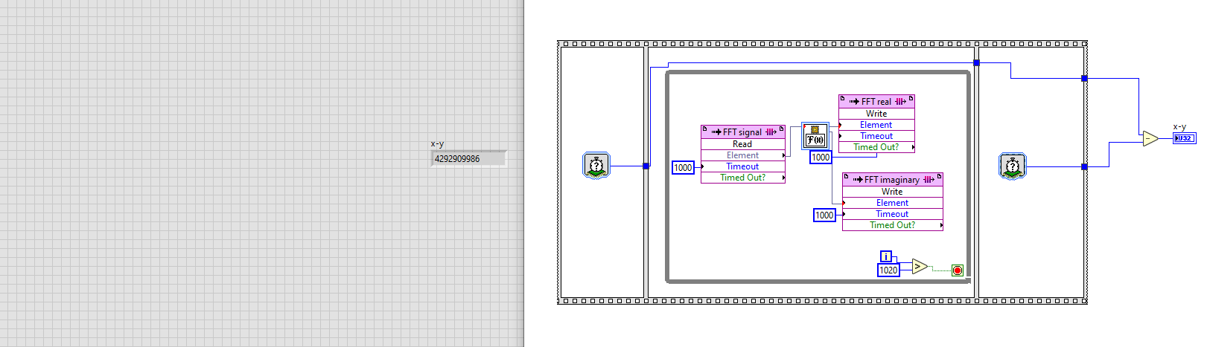
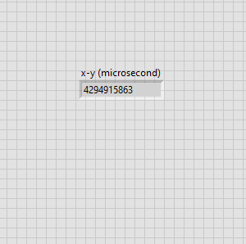
Start from beginning
Build in FPGA (like target)
Simple FFT
Compile

Slide 9
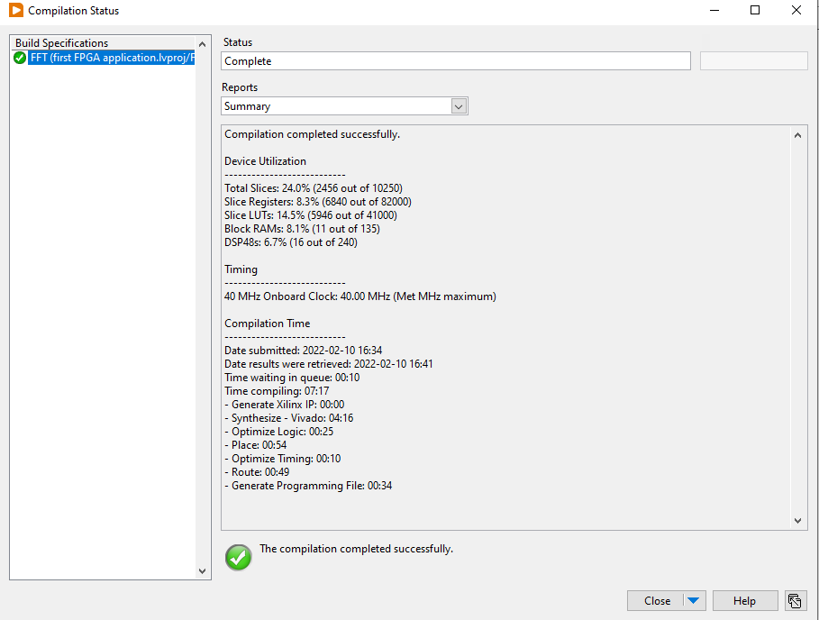
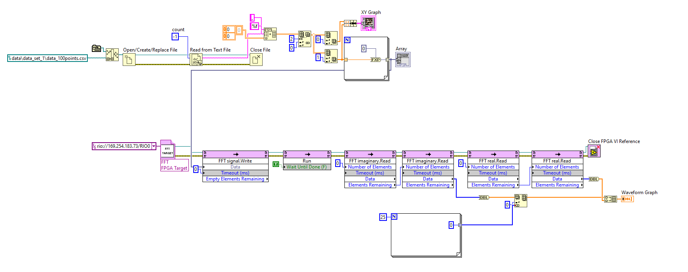
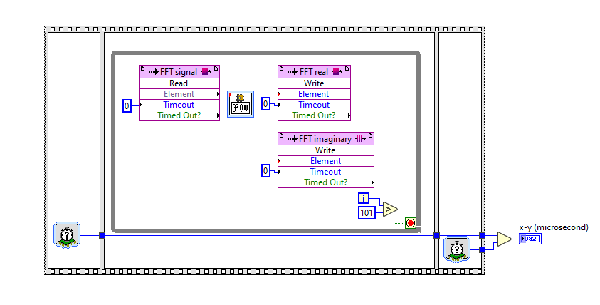
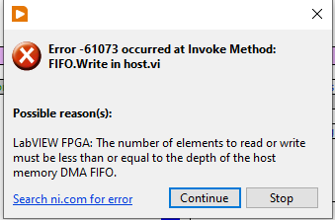
Start from beginning
Build in FPGA (like target)
Simple FFT
Data send from host
Compile

Slide 10
To remove this error
Check input text file
Is there any unnecessary commas

Slide 11
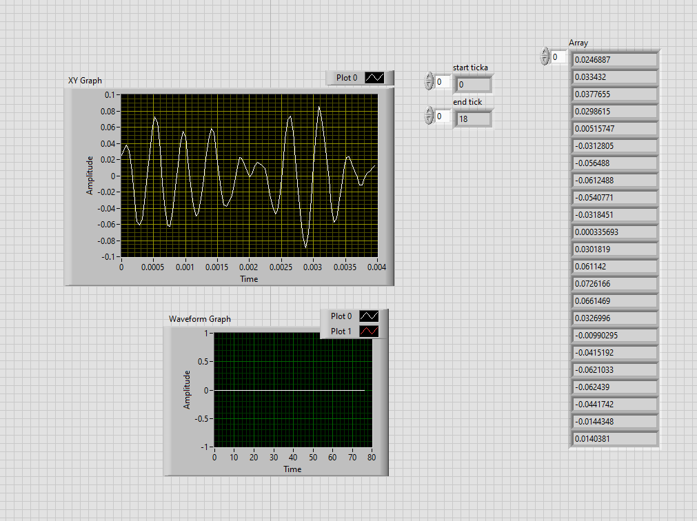
Start from beginning
Build in FPGA (like target)
Simple FFT
Data send from host
Compile

Slide 12
Link of FFT FPGA approach
https://www.edn.com/tip-ffts-in-labview-fpga/
https://knowledge.ni.com/KnowledgeArticleDetails?id=kA03q000000x3ruCAA&l=en-US&nisrc=RSS-crio-en
https://accelconf.web.cern.ch/ICALEPCS2013/papers/tuppc095.pdf
https://www.bing.com/videos/search?q=DMA+FIFO&view=detail&mid=1BF4F8F01C86221C62F51BF4F8F01C86221C62F5&FORM=VIRE

Slide 13
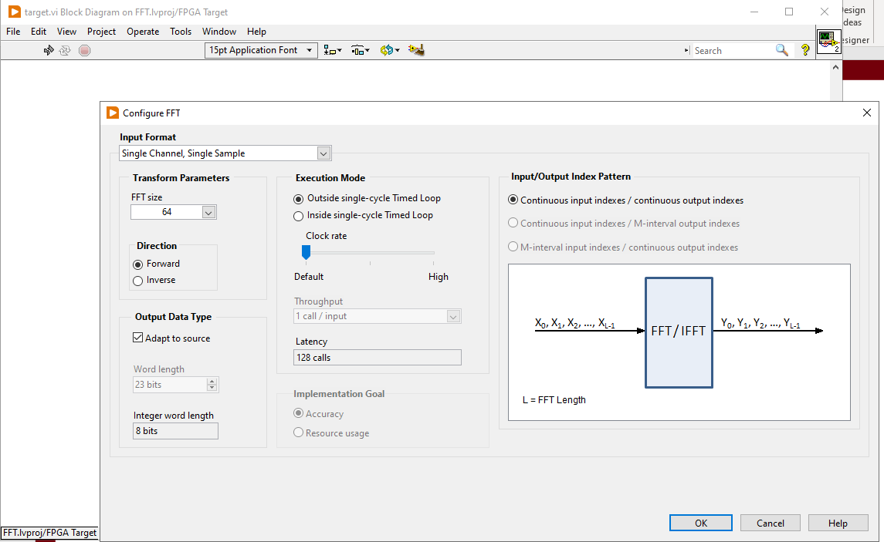
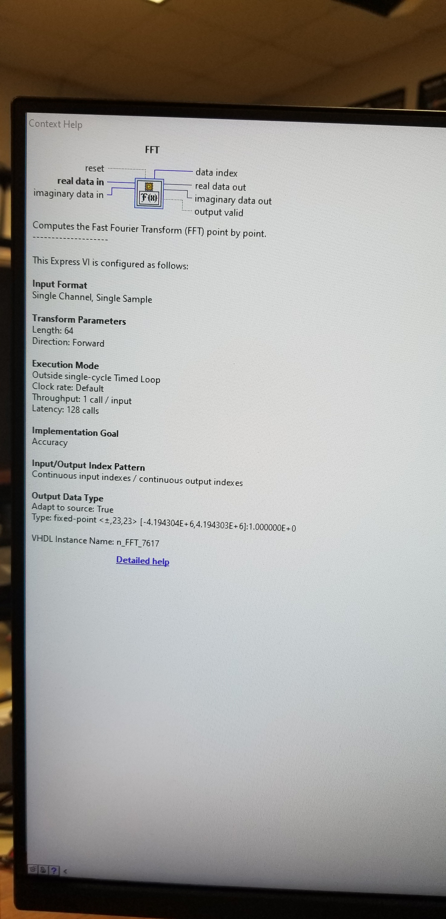
Apprpoach

Slide 14
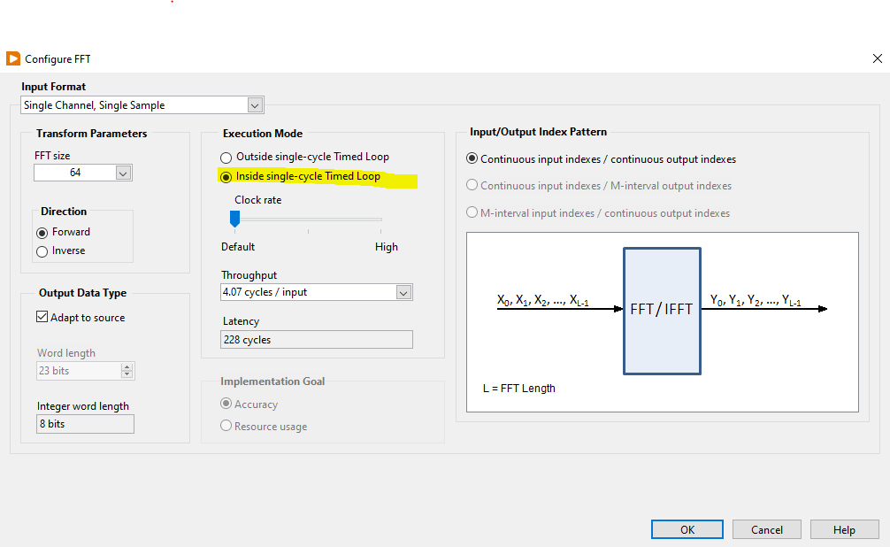
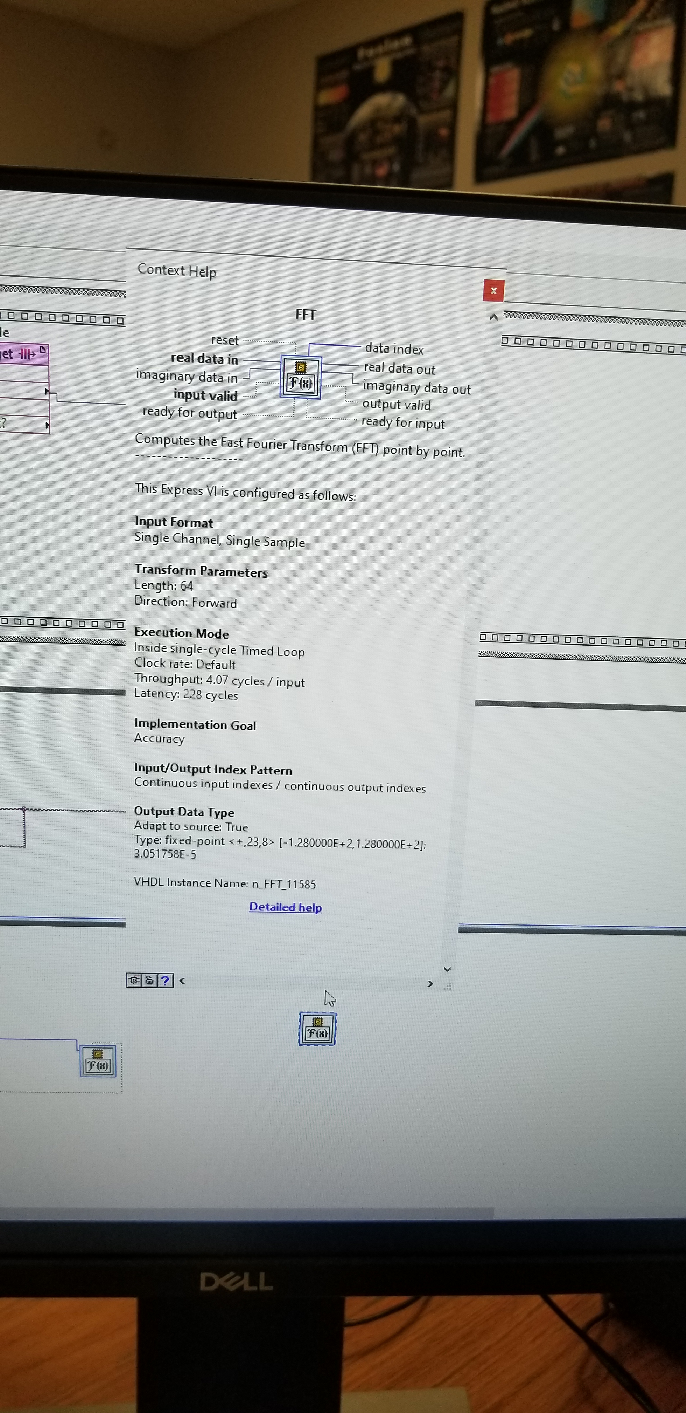
Apprpoach

Slide 15
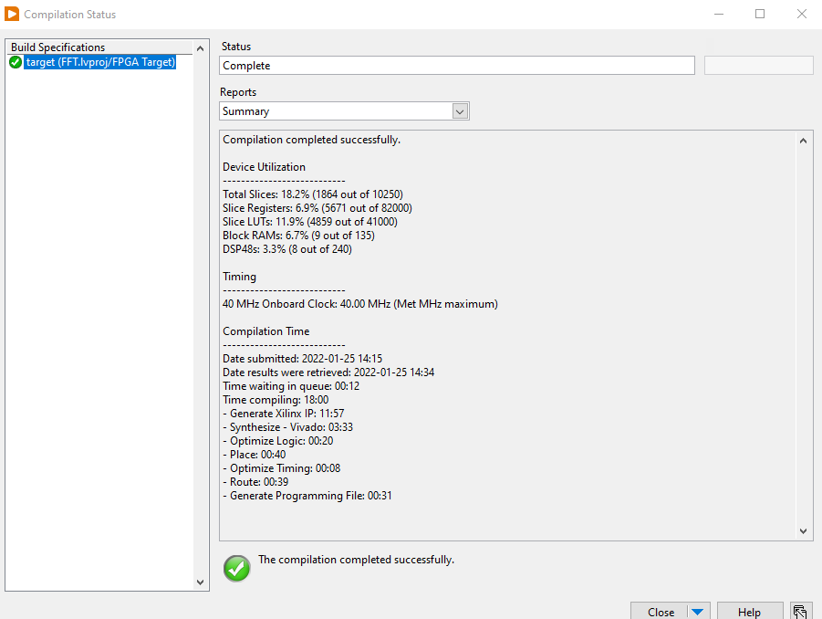

Slide 16
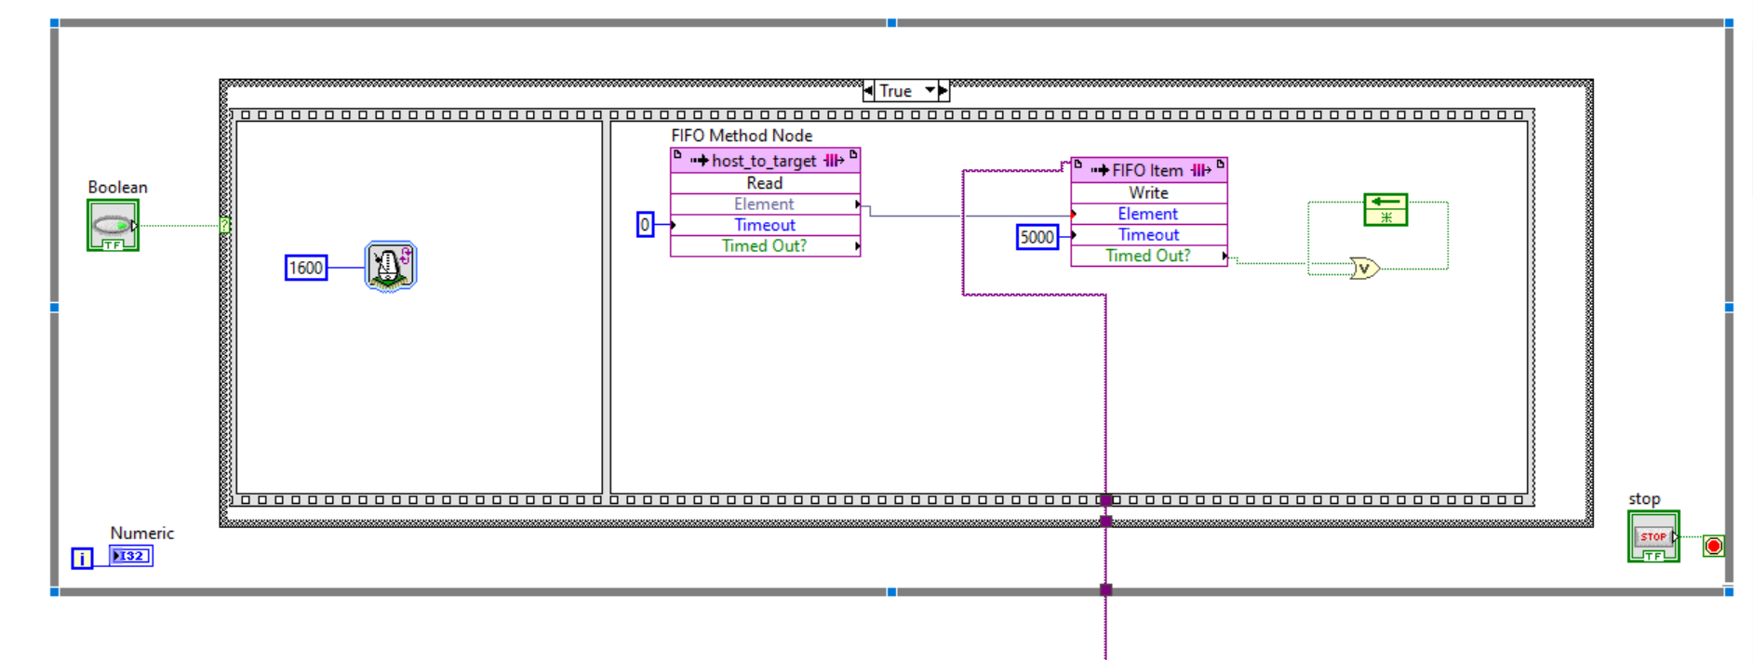
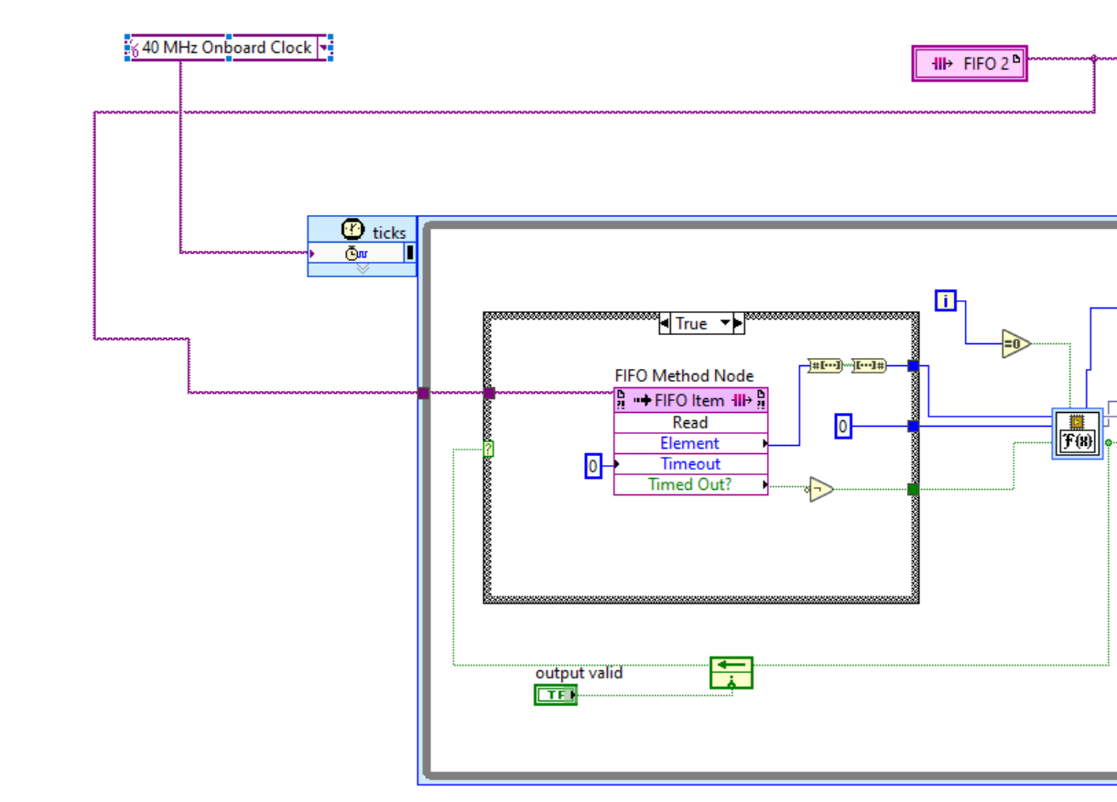
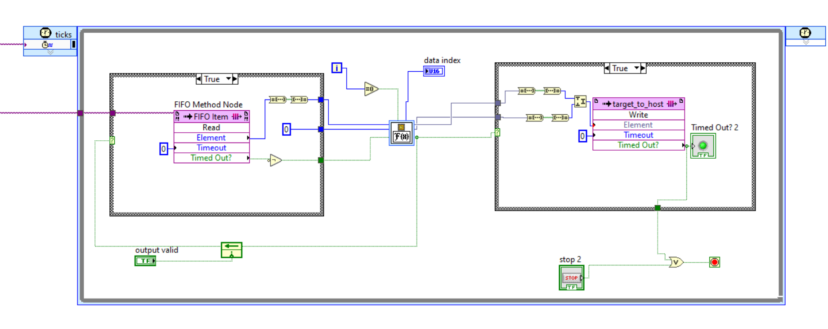

Slide 17
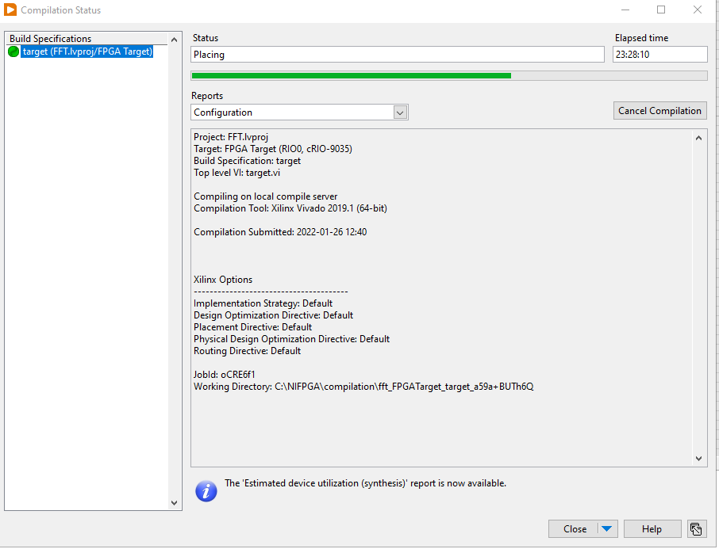
Compile for long time.

Slide 18
Thanks!

